Slide 1
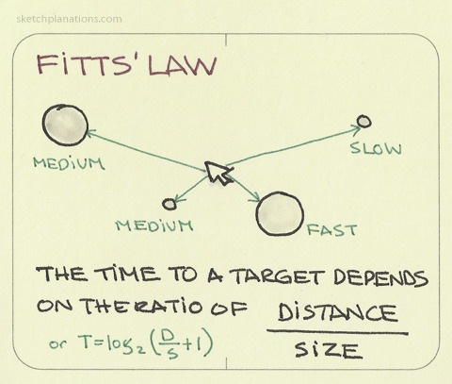
Fitts’s Law
IT 467
Jianwei Lai

Slide 2
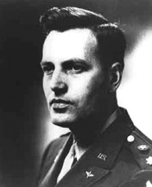
What is Fitts’s law?
Paul M. Fitts was an American psychologist and one of the pioneers in improving aviation safety. He went on to lead the Psychology Branch of Air Force Research Laboratory – later renamed, in his honor, to Fitts Human Engineering Division.
Fitts’s Law was his most famous work. It was first mentioned in a publication in 1954, and first applied to Human-Computer Interaction in 1978.
Unfortunately, Paul Fitts never witnessed that, having died unexpectedly in 1965, at the age of 53.
Paul M. Fitts
Notes:
Before we get to know Fitts’s Law, let’s solve the mystery of its name.

Slide 3
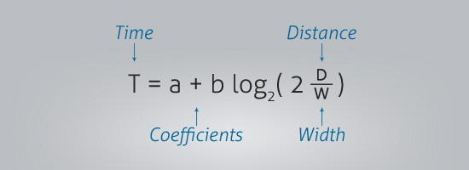
What is Fitts’s law?
Psychologist Paul Fitts (1912-1965) published his theory on “human mechanics and aimed movement” in 1954.
He had seen that the action of pointing at or tapping on a target object could be predicted using mathematics and that it could be measured.
The bigger an object and the closer it is to us, the easier it is to move to.
Notes:
https://www.interaction-design.org/literature/topics/fitts-law
https://medium.com/@deepakdhawan/improving-usability-with-fitts-law-86abfa387c63

Slide 4
Fitts’s law
“Fitts' Law has served as one of the quantitative foundations for human-computer interaction research and design” (Bi et al. 2013)
“[Fitts’ Law] has been used as a theoretical framework for computer input device evaluation, a tool for optimizing new interfaces, a predictive element in complex gesture recognition algorithms, as well as a logical basis for modeling more complex HCI tasks." (Bi et al. 2013)
A demo
http://simonwallner.at/ext/fitts/
Notes:
Bi, X., Li, Y., & Zhai, S. (2013, April). FFitts law: modeling finger touch with fitts' law. In Proceedings of the SIGCHI Conference on Human Factors in Computing Systems (pp. 1363-1372). ACM.

Slide 5
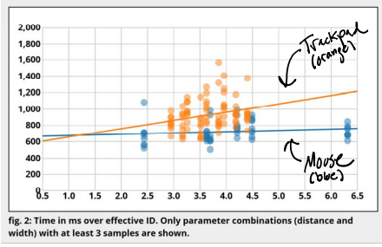
Fitts’s Law helped XEROX Parc see the value of the mouse over other potential input technologies like joysticks
http://instructor.sdu.edu.kz/~ainur/CSI/lectures_2016/week5/Fitts-Law.pdf

Slide 6
Fitts’ Law (Paul Fitts, 1954)
Index of Difficulty (ID )
Task difficulty is analogous to information - execution interpreted as human rate of information processing
Index of Performance (IP ) = ID/MT (bits/s)
W
D
http://www.public.asu.edu/~shannonr/Lab3.htm

Slide 7
MT (secs)
*
*
*
*
*
*
*
*
different way to calculate IP
*
*
*
*
*
*
*
*
*
*
b = slope
IP = 1/b
*
*
*
*
*
*
*
*
*
*
*
a
*
ID (bits)
log₂(D/W + 1)

Slide 8
50 years of data
Reference:
MacKenzie, I. Fitts’ Law as a research and design tool in human computer interaction. Human Computer Interaction, 1992, Vol. 7, pp. 91-139

Slide 9
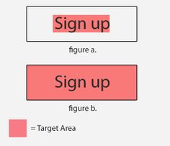


Use of Fitts’s Law

Slide 10
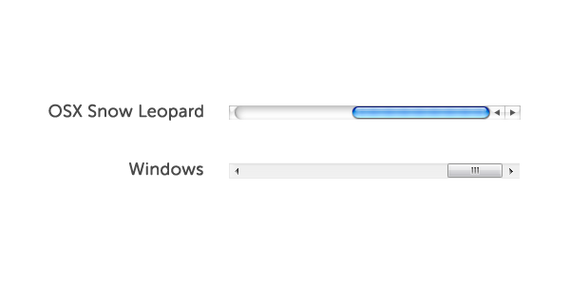
Use of Fitts’s Law
Windows vs. the Mac

Slide 11
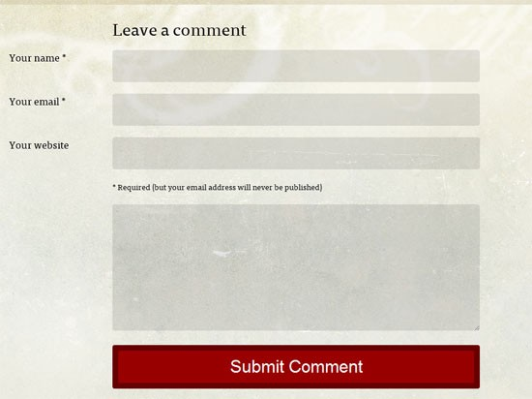
The larger the better?

Slide 12
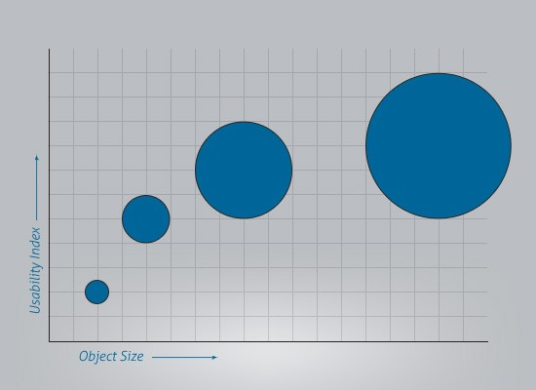
Fitts’ law is a binary logarithm. This means that the predicted results of the usability of an object runs along a curve, not a straight line.
https://medium.com/@deepakdhawan/improving-usability-with-fitts-law-86abfa387c63

Slide 13
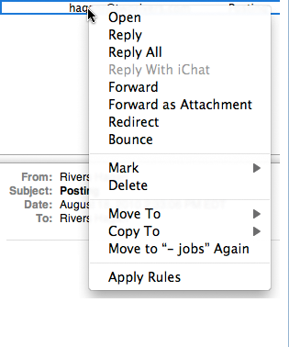
Prime Pixel
The prime pixel is the reference used for the single point of space that your input device’s cursor is currently on.
For example, contextual menu

Slide 14
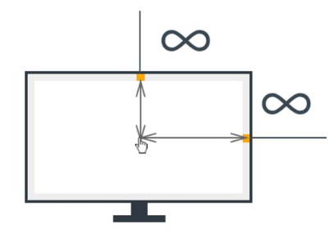
Edge of the screen

Slide 15
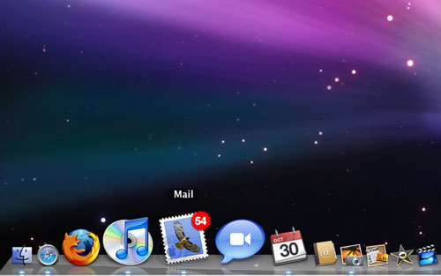



Slide 16
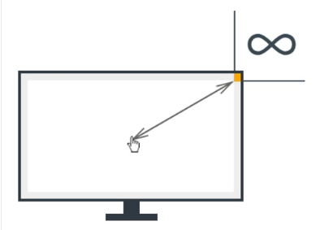
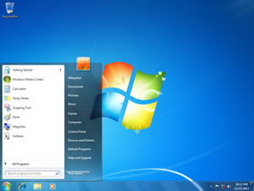
Corners of the Screen-Magic Pixels

Slide 17

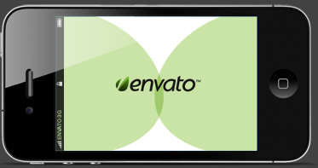
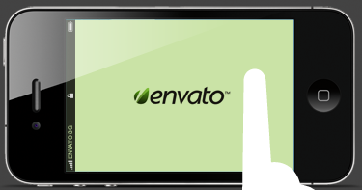
Applying Fitts’s Law To Mobile Interface Design
Common thumb reach when holding smartphone in horizontal orientation
Hold and point mode
Common thumb reach when held with right hand
https://webdesign.tutsplus.com/articles/applying-fitts-law-to-mobile-interface-design--webdesign-6919

Slide 18
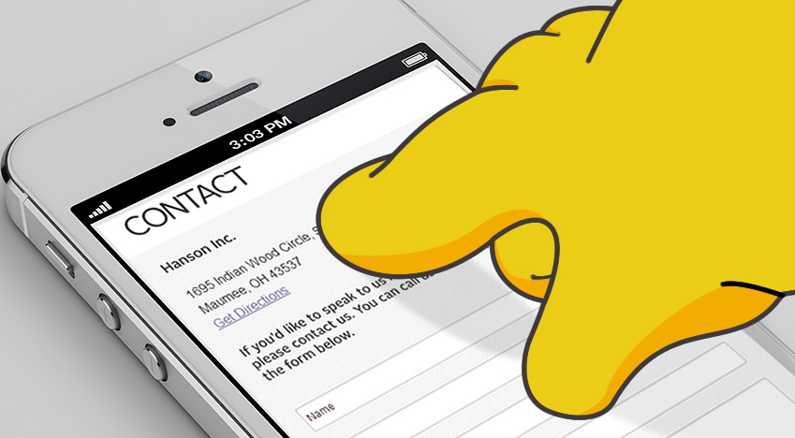

Touch input on smartphones = Fitts’ Law + Fat Finger Problem = FFitts’ Law
Bi, X., Li, Y., & Zhai, S. (2013, April). FFitts law: modeling finger touch with fitts' law. In Proceedings of the SIGCHI Conference on Human Factors in Computing Systems (pp. 1363-1372). ACM.
https://storage.googleapis.com/pub-tools-public-publication-data/pdf/41645.pdf

Slide 19
Demo of Fitts’s Law
http://fww.few.vu.nl/hci/interactive/fitts/

